Slide 1
LVMs (Contd), Expectation Maximization (2)
CS771: Introduction to Machine Learning
Piyush Rai

Slide 2
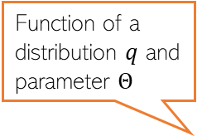


What is EM Doing?
Assuming $Z$ to be discrete, else replace it by an integral
Maximizing ILL
The MLE problem was $Θ_{MLE}=arg\max_{Θ} log p\left(X | Θ\right)= arg\max_{Θ} log\sum_{z}{p\left(X,Z | Θ\right)}$
What EM (and ALT-OPT in a crude way) did is max of CLL: $Θ_{MLE}=arg\max_{Θ} 𝔼\left[log p\left(X,Z | Θ\right)\right]$
But we did not solve the original problem. Is it okay?
Assume $p_{z} = p(Z|X,Θ)$ and $q(Z)$ to be some prob distribution over $Z,$ then
In the above $ℒ\left(q,Θ\right)= \sum_{Z}{q\left(Z\right)log\left\{\frac{p(X,Z|Θ)}{q(Z)}\right\}}$ and $KL(q|\left|p_{z}\right)=−\sum_{Z}{q\left(Z\right)log\left\{\frac{p(Z|X,Θ)}{q(Z)}\right\}}$
Since KL is always non-negative $log p\left(X | Θ\right)≥$ $ℒ\left(q,Θ\right)$, so $ℒ\left(q,Θ\right)$ is a lower-bound on ILL
Thus if we maximize $ℒ\left(q,Θ\right)$, it will also improve $log p\left(X | Θ\right)$
Easier than maximizing ILL
Function of a distribution $q$ and parameter $Θ$
$$log p\left(X | Θ\right)= ℒ\left(q,Θ\right)+KL(q||p_{z})$$
May verify this identity

Slide 3

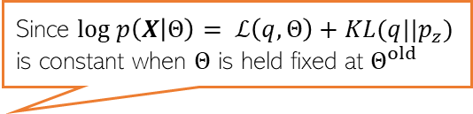
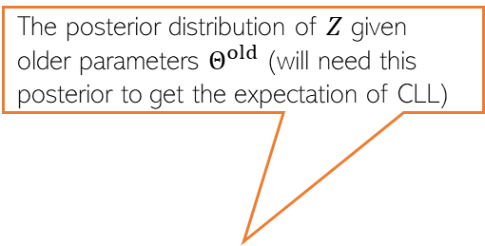
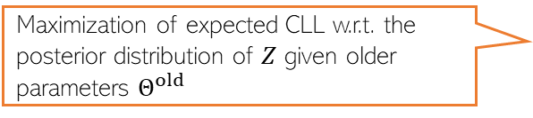


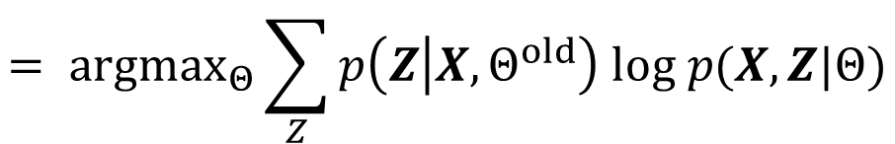
What is EM Doing?
The posterior distribution of $Z$ given older parameters $Θ^{old}$ (will need this posterior to get the expectation of CLL)
As we saw, $ℒ\left(q,Θ\right)$ depends on $q$ and $Θ$
Let’s maximize $ℒ\left(q,Θ\right)$ w.r.t. $q$ with $Θ$ fixed at $Θ^{old}$
Now let’s maximize $ℒ\left(q,Θ\right)$ w.r.t. $Θ$ with $q$ fixed at $\hat{q}=p_{z}=p(Z|X,Θ^{old})$
Since $log p\left(X | Θ\right)= ℒ\left(q,Θ\right)+KL(q||p_{z})$ is constant when $Θ$ is held fixed at $Θ^{old}$
$$\hat{q}= {argmax}_{q}ℒ\left(q,Θ^{old}\right)= {argmin}_{q}KL(q|\left|p_{z}\right)=p_{z}=p(Z|X,Θ^{old})$$
$$Θ^{new}= {argmax}_{Θ}ℒ\left(\hat{q},Θ\right)= {argmax}_{Θ}\sum_{Z}{p(Z|X,Θ^{old}) log\left\{\frac{p(X,Z|Θ)}{p(Z|X,Θ^{old}) }\right\}}$$
$$= {argmax}_{Θ}\sum_{Z}{p\left(Z | X,Θ^{old}\right) log p(X,Z|Θ)}$$
Maximization of expected CLL w.r.t. the posterior distribution of $Z$ given older parameters $Θ^{old}$
$$= {argmax}_{Θ} 𝔼_{p\left(Z | X,Θ^{old}\right)}[log p(X,Z|Θ)]$$
$$= {argmax}_{Θ} 𝒬(Θ,Θ^{old})$$

Slide 4
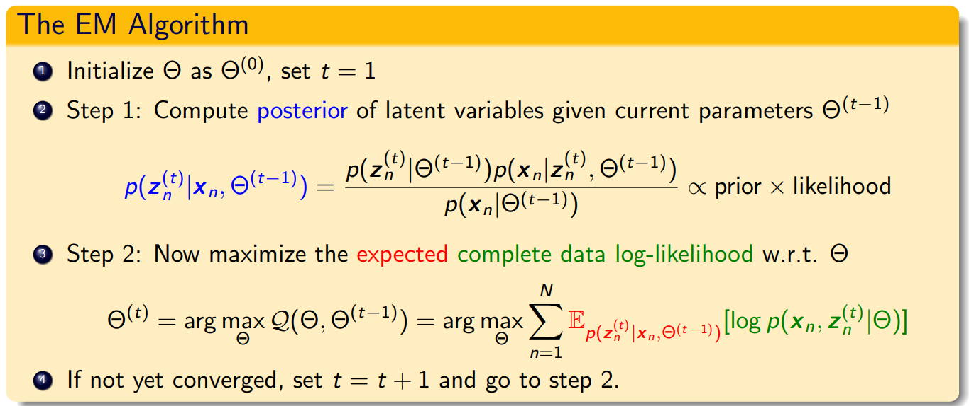

The EM Algorithm in its general form..
Maximization of $ℒ\left(q,Θ\right)$ w.r.t. $q$ and $Θ$ gives the EM algorithm (Dempster, Laird, Rubin, 1977)
Note: If we can take the MAP estimate ${\hat{z}}_{n}$ of $z_{n}$ (not full posterior) in Step 1 and maximize the CLL in Step 2 using that, i.e., do ${argmax}_{Θ}\sum_{n=1}^{N}{\left[log p\left(x_{n}, {{\hat{z}}_{n}}^{(t)} | Θ\right)\right]}$ this will be ALT-OPT

Slide 5
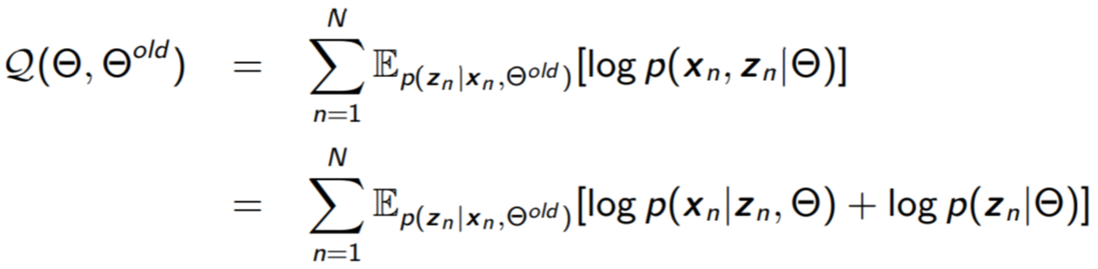
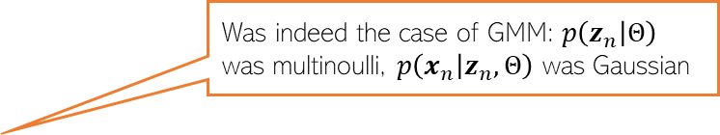
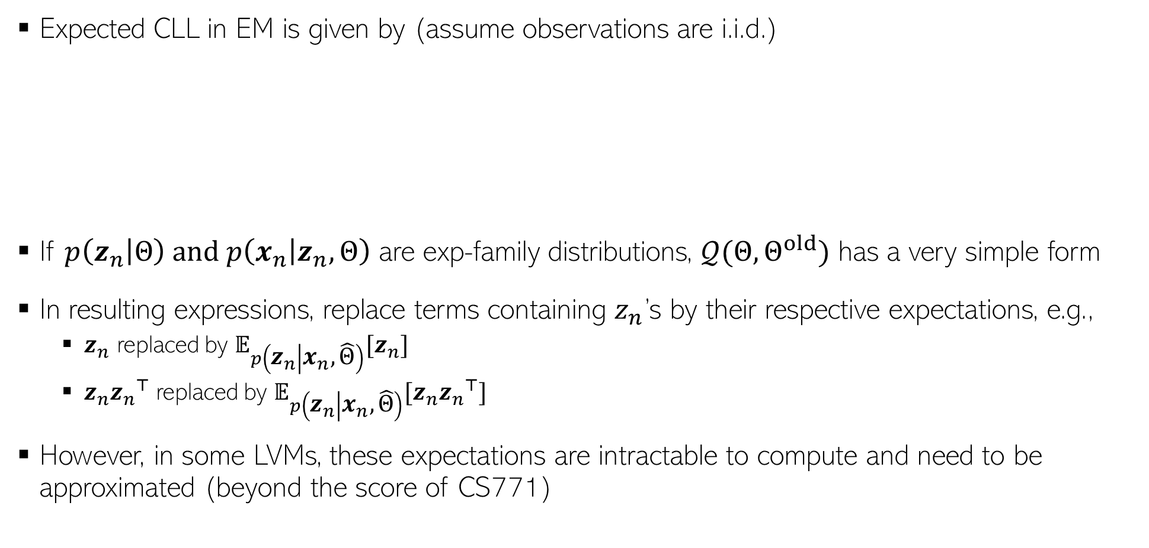
The Expected CLL
Expected CLL in EM is given by (assume observations are i.i.d.)
If $p\left(z_{n} | Θ\right)$ and $p\left(x_{n} | z_{n},Θ\right)$ are exp-family distributions, $𝒬(Θ,Θ^{old})$ has a very simple form
In resulting expressions, replace terms containing $z_{n}$’s by their respective expectations, e.g.,
$z_{n}$ replaced by $𝔼_{p\left(z_{n} | x_{n},\hat{Θ}\right)}[z_{n}]$
$z_{n}{z_{n}}^{⊤}$ replaced by $𝔼_{p\left(z_{n} | x_{n},\hat{Θ}\right)}[z_{n}{z_{n}}^{⊤}]$
However, in some LVMs, these expectations are intractable to compute and need to be approximated (beyond the score of CS771)
Was indeed the case of GMM: $p\left(z_{n} | Θ\right)$ was multinoulli, $p\left(x_{n} | z_{n},Θ\right)$ was Gaussian

Slide 6


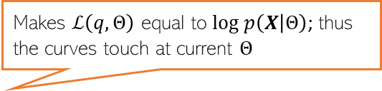

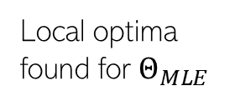
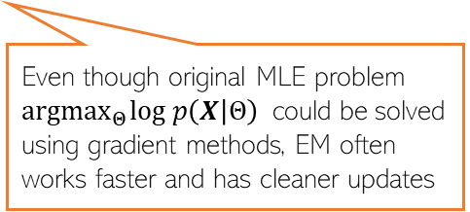




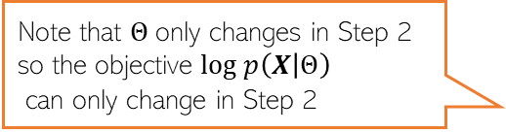


EM: An Illustration
Alternating between them until convergence to some local optima
Makes $ℒ\left(q,Θ\right)$ equal to $log p\left(X | Θ\right)$; thus the curves touch at current $Θ$
As we saw, EM maximizes the lower bound $ℒ\left(q,Θ\right)$ in two steps
Step 1 finds the optimal $q$ (call it $\hat{q}$) by setting it the posterior of $Z$ given current $Θ$
Step 2 maximizes $ℒ\left(\hat{q},Θ\right)$ w.r.t. $Θ$which gives a new $Θ$.
Note that $Θ$only changes in Step 2 so the objective $log p\left(X | Θ\right)$
can only change in Step 2
Local optima found for $Θ_{MLE}$
Green curve: $ℒ\left(\hat{q},Θ\right)$ after setting $q$ to $\hat{q}$
$$log p\left(X | Θ\right)$$
Also kind of similar to Newton’s method (and has second order like convergence behavior in some cases)
Good initialization matters; otherwise would converge to a poor local optima
Unlike Newton’s method, we don’t construct and optimize a quadratic approximation, but a lower bound
Even though original MLE problem ${argmax}_{Θ}log p\left(X | Θ\right)$ could be solved using gradient methods, EM often works faster and has cleaner updates
$$Θ^{(0)}$$
$$Θ^{(1)}$$
$$Θ^{(2)}$$
$$Θ^{(3)}$$
$$Θ^{(MLE)}$$

Slide 7
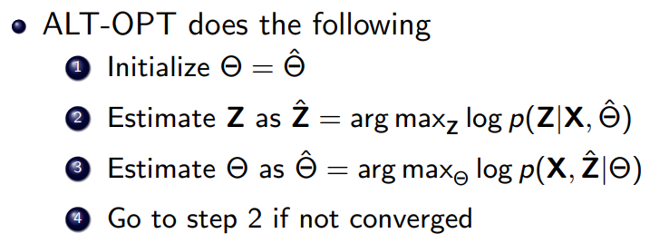
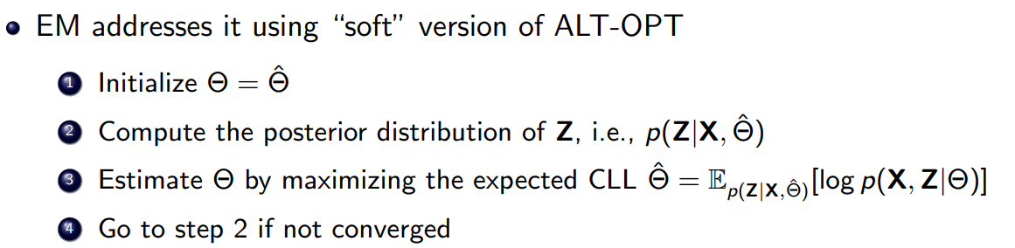


Recap: ALT-OPT vs EM
This step could potentially throw away a lot of information about the latent variable $Z$
ALT-OPT can be seen as as approximation of EM – the posterior $p(Z|X,Θ)$ is replaced by a point mass at its mode

Slide 8

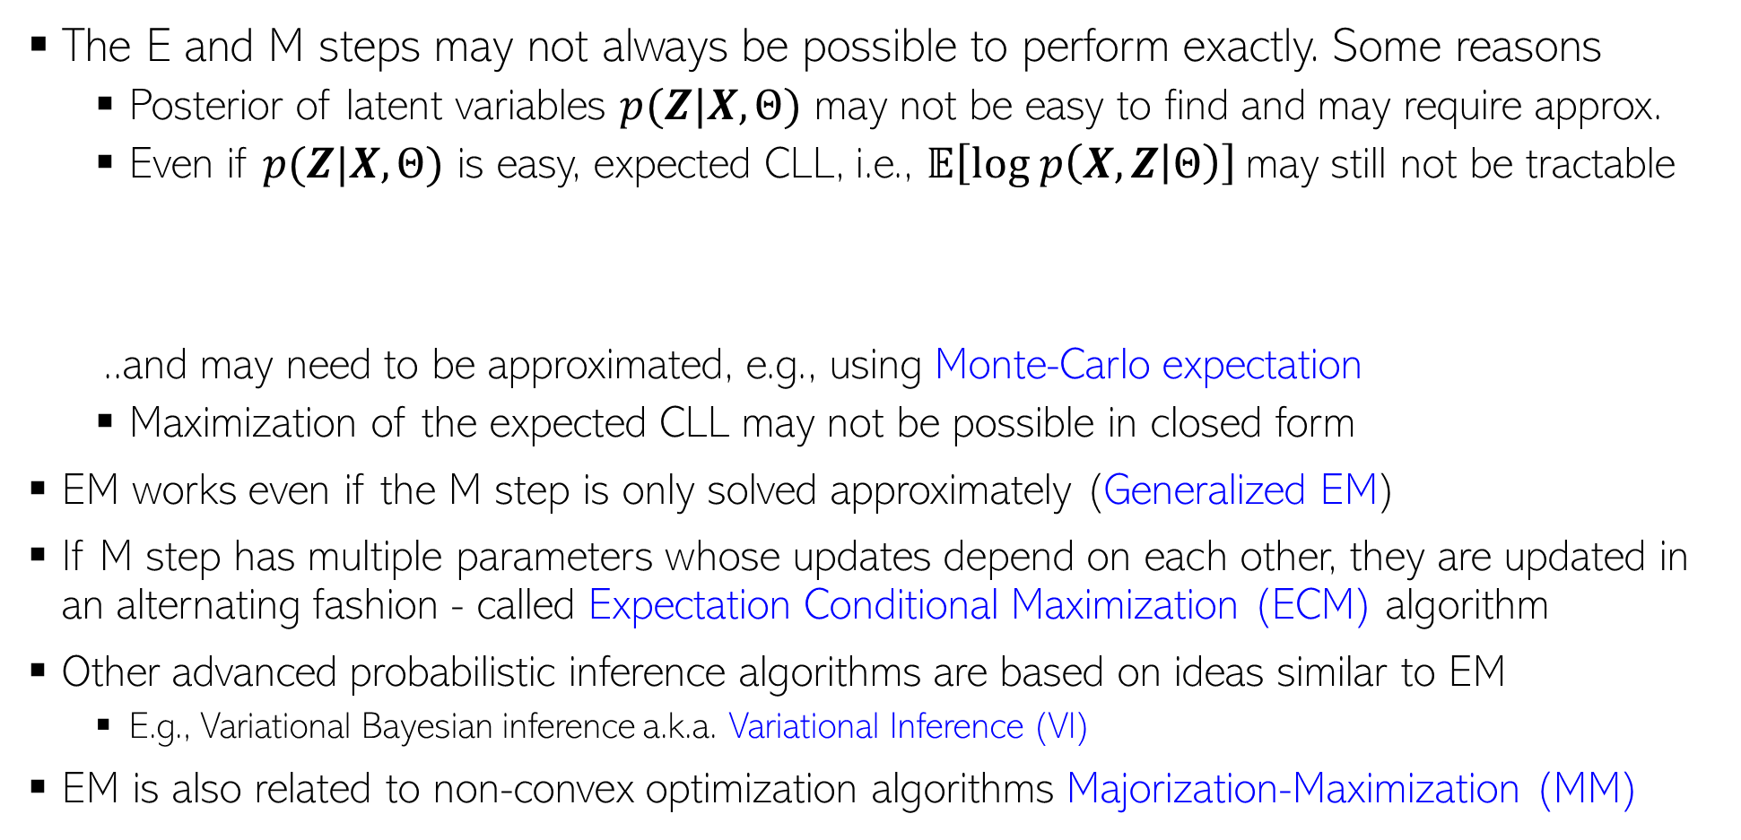
EM: Some Comments
The E and M steps may not always be possible to perform exactly. Some reasons
Posterior of latent variables $p(Z|X,Θ)$ may not be easy to find and may require approx.
Even if $p(Z|X,Θ)$ is easy, expected CLL, i.e., $𝔼\left[log p\left(X,Z | Θ\right)\right]$may still not be tractable
..and may need to be approximated, e.g., using Monte-Carlo expectation
Maximization of the expected CLL may not be possible in closed form
EM works even if the M step is only solved approximately (Generalized EM)
If M step has multiple parameters whose updates depend on each other, they are updated in an alternating fashion - called Expectation Conditional Maximization (ECM) algorithm
Other advanced probabilistic inference algorithms are based on ideas similar to EM
E.g., Variational Bayesian inference a.k.a. Variational Inference (VI)
EM is also related to non-convex optimization algorithms Majorization-Maximization (MM)
Monte-Carlo EM
Gradient methods may still be needed for this step

